Slide 1
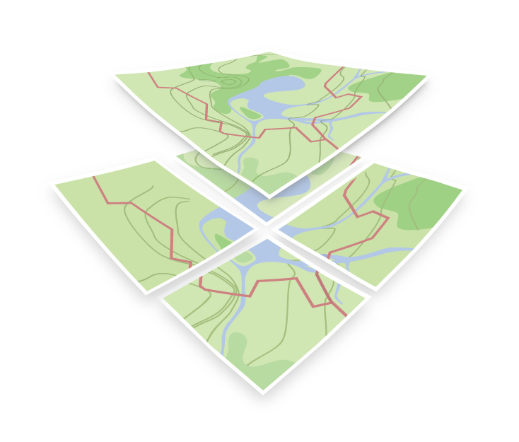
OGC API Maps and Tiles
OGC API Hackathon 2019
London, United Kingdom
20 June 2019

Slide 2
Introduction
Defines an OGC standard for a Web Map and Tile API that can serve map tiles and/or maps of spatially referenced data
It will probably be composed by a family of conformance classes/standards/documents
Describes the discovery and query operations of an API that provides access to Maps and Tiles in a manner independent of the underlying data store
Builds upon (and unifies) the WMS 1.3 and WMTS 1.0 standards and recent work on Tiled Feature Data (a.k.a. vector tiles).
Uses the recently approved 17-083r1 OGC Tile Matrix Set Standard (web publication pending. Available on “pending”) as a baseline to describe tiles tile spaces and tile schemas.

Slide 3
OGC API Maps and Tiles – Paths (1)
Path = /
Returns landing page (inherited from OGC API - Common)
Path = /conformance
Returns a set of conformance class URIs. (inherited from OGC API - Common)
Path = /collections
Returns metadata describing the collections accessible through this API (inherited from OGC API - Common)
Path = /collections/{collectionId}
Returns metadata describing if a {collectionId} is available as a map or as tiles
Path = /tileMatrixSet
Returns all available tile matrix sets (tiling schemes)
Path = /tileMatrixSet/{tileMatrixSetId}
Returns a tiling scheme by id

Slide 4
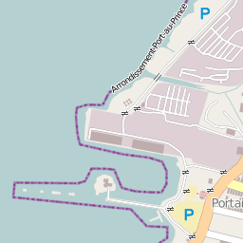
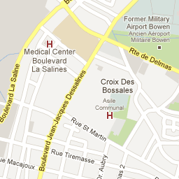
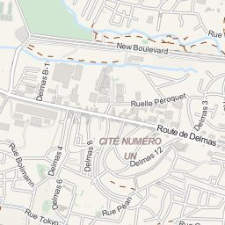
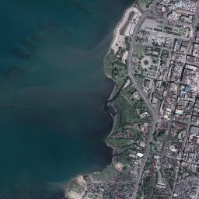
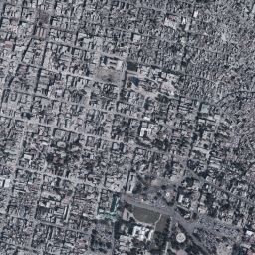
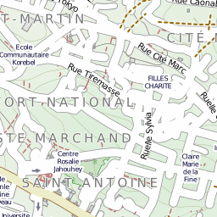
OGC API Tiles – Paths (2)
Path = /tiles/{styleId}/ {tileMatrixSetId}/{tileMatrix}/{tileRow}/{tileCol}
Returns a tile of the dataset
Path = /collections/{collectionId}/tiles/{styleId}/ {tileMatrixSetId}/{tileMatrix}/{tileRow}/{tileCol}
Returns a tile of the collection
Path = /tiles/{styleId}/{tileMatrixSetId}/{tileMatrix}/{tileRow}/{tileCol}/info
Returns information on a point of a tile
Path = /collections/{collectionId}/tiles/{styleId}/ {tileMatrixSetId}/{tileMatrix}/{tileRow}/{tileCol}/info
Returns information of a point in a tile of the collection
a.tile.openstreetmap.org
mt1.google.com
otile1.mqcdn.com/tiles/1.0.0/map
X=9798
Y=14664
X=9799
Y=14664
X=9800
Y=14664
www.ogc.uab.cat/SITiled/GeoEye_Haiti_M
tile.opencyclemap.org/cycle
X=9798
Y=14665
X=9799
Y=14665
X=9800
Y=14665
ecn.t0.tiles.virtualearth.net

Slide 5
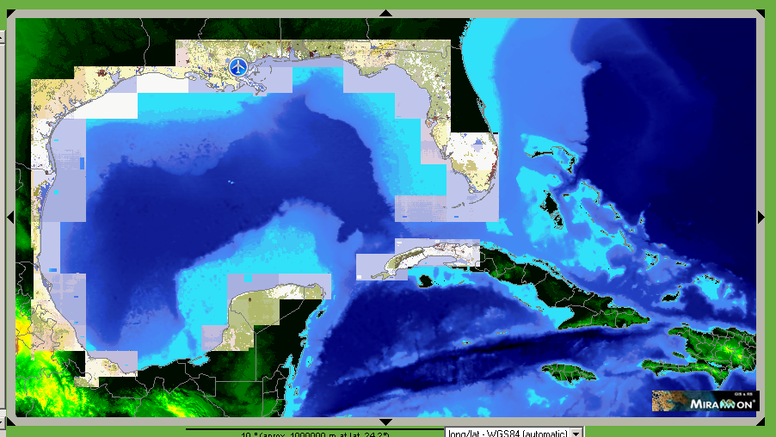
OGC API Maps – Paths (3)
Path = /map
Returns a map of the dataset
Path = /collections/{collectionId}/map/{styleId}/
Returns a map of a collection
Path = /map/info
Returns information on a point of a map
Path = /collections/{collectionId}/map/{styleId}/info
Returns information of a point in a map of a collection

Slide 6
OGC API MultiTile – Paths (4)
Path = /tiles/{tileMatrixSetId}
Returns tiles from several collections.
Path = /collections/{collectionId}/tiles/{tileMatrixSetId}
Returns tiles of a collection

Slide 7
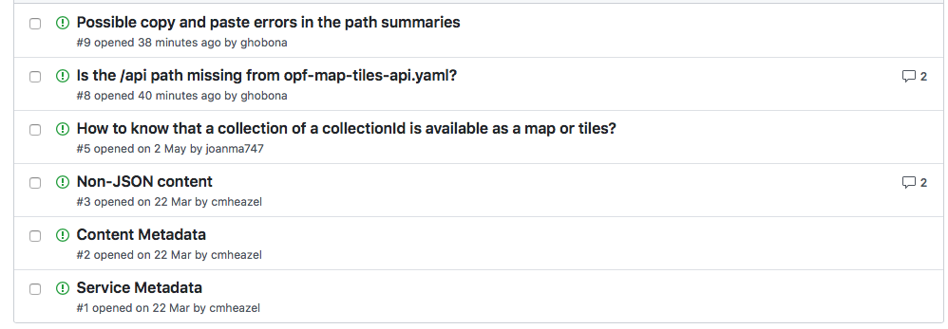
Issues
https://github.com/opengeospatial/OGC-API-Map-Tiles/issues

Slide 8
Points of Contact:
Joan Maso
Joan.Maso@uab.cat
Núria Julià
N.Julia@creaf.uab.cat

